Slide 1



PROJECT STATUS: PRODUCTION READY
SENTINEL-DF
Autonomous Edge-Based Deepfake Detection System

Slide 2
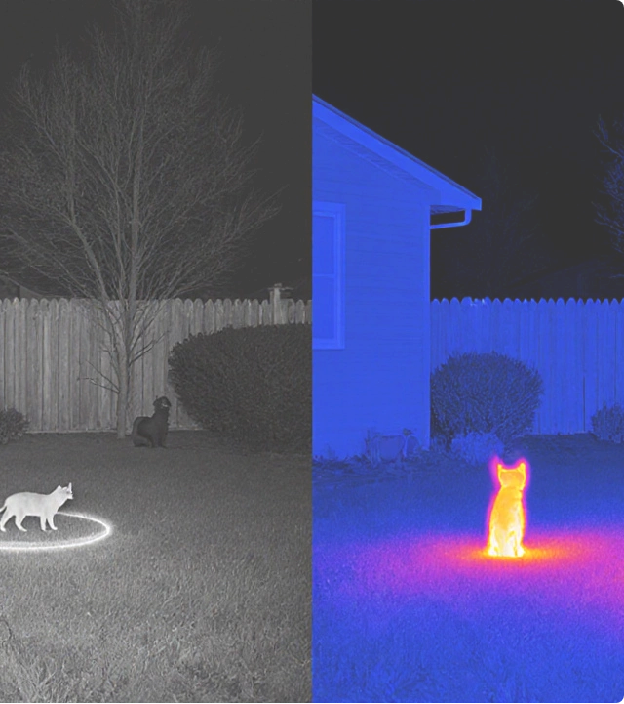



Mission Critical Capabilities
Edge-First Design
Runs natively on smartphones and body-cams with 100% offline capability. Zero cloud dependencies ensuring operation in signal-denied environments.
Fail-Secure Architecture
Production-hardened design with rigorous adversarial testing. Includes chain-of-custody logging for judicial admissibility.

Slide 3



System Performance Metrics
Optimization Strategy
71.7%
~50ms
Achieved through aggressive quantization and architecture tuning:
ACCURACY (TEST BATCH)
INFERENCE TIME (CPU)
>
Architecture: (Transfer Learning)
>
Input Resolution: 224x224x3 RGB
14.2 MB
<200 MB
>
Optimization: Quantized TFLite format
MODEL SIZE
RAM USAGE
>
Frame Throttling: ~12 FPS processed (1 in 5 frames) to reduce battery drain by 80%.

Slide 4




Machine Learning Architecture
Model Training
Python Backend
>
Base: MobileNetV2 (ImageNet Pretrained)
>
Core: Python 3.8+, TensorFlow 2.19.0
>
Dataset: 21.8k Images (5.2k Real, 16.5k Fake)
>
Processing: OpenCV 4.8.0+ for Haar Cascade Face Extraction
>
Augmentation: Rotation, Zoom, Brightness, Flip
>
Loss Function:
>
Pipeline: Auto-export to TFLite + Keras H5
>
Input: Supports .mp4, .avi, .mov batch processing

Slide 5
Robustness & Validation
System behavior under simulated field stress conditions:
Test Scenario | Condition | Result
Deepfake Injection | Standard test batch injection | 71.7% Confidence
Low Light Sabotage | Luminance < 30/255 | Warning Triggered
Physical Occlusion | Sensor blocked / Face partial | Fail-Secure
Security Note: The system defaults to a 'Fail-Secure' state, preventing false authentications when data quality is compromised.

Slide 6

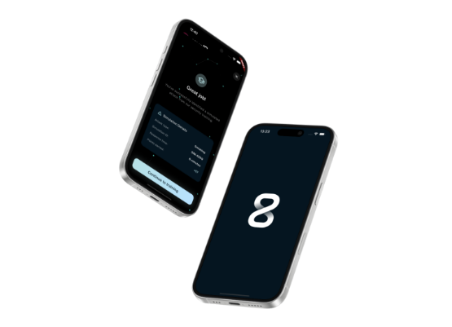
Mobile Interface (Flutter)
Tactical User Experience
>
Framework: Flutter 3.0+ / Dart
>
Inference:
>
Visuals: Dark theme optimized for low-light tactical environments.
>
Real-Time HUD:
>
Confidence Meter Visualization
>
Instant AUTHENTIC/DEEPFAKE Verdict
>
Lip Sync & Skin Texture Indicators

Slide 7






Cognitive Assistance Features
Environmental Awareness
Quality Gatekeeping
Visual Artifact Scoring
Automatic brightness analysis checks for luminance <30/255. Proactively suggests Infrared Mode to the operative.
Real-time validation of face detection confidence, image resolution, and sensor occlusion before processing.
Provides granular feedback on specific fail points: Lip Sync errors, Skin Texture anomalies, and Blending artifacts.

Slide 8

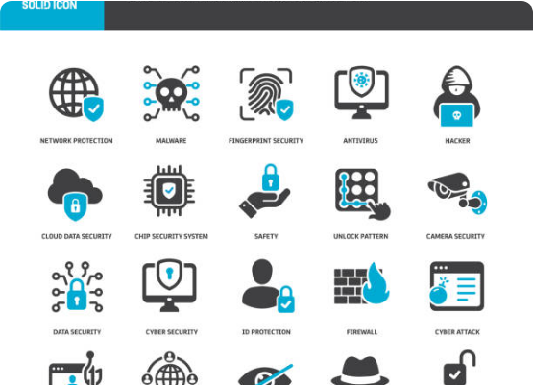
Forensic Integrity
Court-Admissible Evidence
>
Cryptographic Logging: SHA-256 hashing of all events.
>
Tamper-Proofing: Immutable audit trail of every scan.
>
Secure Export: JSON generation including metadata, timestamps, and model version hashes.
>
Validation: Evidence packages generated directly on-device.

Slide 9
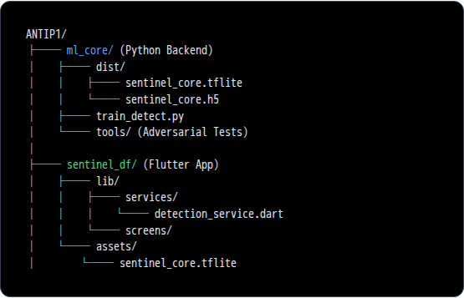

Deployment Architecture
DevOps & Tooling
>
Version Control: Git + Git LFS
>
Packaging:
>
(3.7 MB) - Mobile
>
(14 MB) - Training
>
- Android Build
>
Platforms: Android, Linux (Dev), iOS (Compatible)

Slide 10
Complete Technology Stack
ML Frameworks | TensorFlow 2.19.0, TFLite 2.14.0+, Keras 2.19.0
Computer Vision | OpenCV 4.8.0+, Haar Cascade, BlazeFace
Mobile Dev | Flutter 3.0+, Dart, tflite_flutter, image_picker
Python Stack | Python 3.8+, NumPy, SciPy, Pillow, FFmpeg
Web (Experimental) | TensorFlow.js 4.20.0, PWA Service Workers

Slide 11






Key Differentiators
100% Offline
Low-Power Optimized
Chain of Custody
Adversarial Tested
No cloud dependencies. True edge computing security.
SHA-256 cryptographic logging for evidence integrity.
Validated against deepfake injection and low-light sabotage.
Intelligent frame throttling reduces CPU load by 80%.

Slide 12
Q&A
SENTINEL-DF
https://github.com/Hitanshu-cyber/sentinel-df

Slide 13



Image Sources
>
https://birminghamcontrolcentre.co.uk/uploads/2025/10/split-view-of-infrared-camera-grayscale-and-thermal-heat-map-of-a-backyard.-seeing-in-the-dark-without-light-practical-night-vision-techniques-tools.webp
Source: birminghamcontrolcentre.co.uk
>
https://cdn.prod.website-files.com/67fd2c83be0cd4f397b3a2b2/6841814bd62fc8932a7a1ddc_iPhone%2016%20(1).png
Source: www.revel8.ai
>
https://media.istockphoto.com/id/1813253153/vector/cyber-security-solid-icons-containing-malware-hacker-spyware-data-security-icons-collection.jpg?s=612x612&w=0&k=20&c=f9uszrYuTvYkhVy0Gc-ybVJ22QBEy5sAx4Kra6jzbKE=
Source: www.istockphoto.com

